Slide 1
EEL
David Londono
Gayathri Srinivasan
Taweh Browne
Marcus King

Slide 2
Purpose
To challenge the users by maneuvering an eel in numerous directions in order to acquire the block that is located on the screen.

Slide 3
How The App Works
Overview- Users will continuously move an eel around the playing field to acquire a block. To continue progressing through the app users will have to collect the blocks without touching the border of the playing field. If the users touch the wall, the round ends.
The app contains three different modes: easy, medium, hard, and extreme.

Slide 4
Modifications
The app we made was inspired by the original game Snake
We decided to change the name to EEL and changed the whole theme of the game.
We changed many of the buttons in order to make it easier for the user.
We also made it available to play on landscape mode so the user can play in a different sized screen.

Slide 5
Graphics
Created logo using Photoshop
Also used Photoshop to help add filters to our background
Created theme to visualize a game underwater.

Slide 6
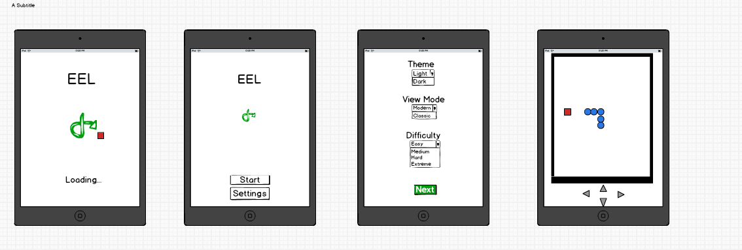
Original Layout

